Slide 1
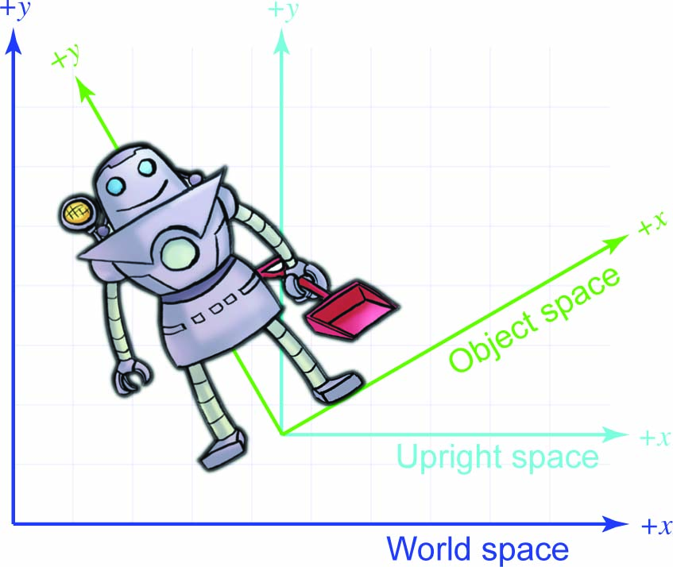

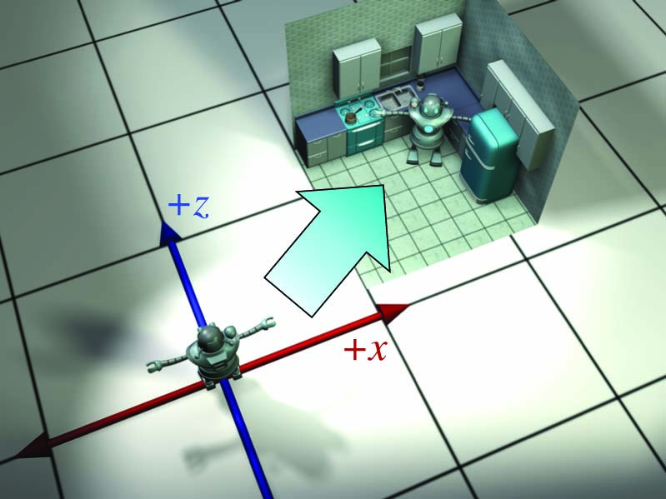
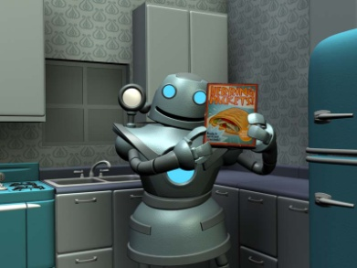
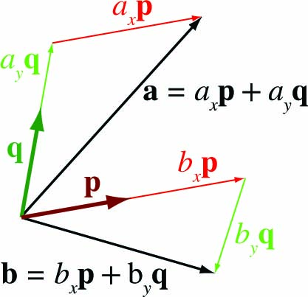
Chapter 3: Multiple Coordinate Spaces
Fletcher Dunn
Valve Software
Ian Parberry
University of North Texas
3D Math Primer for Graphics and Game Development

Slide 2
What You’ll See in This Chapter
This chapter introduces the idea of multiple coordinate systems. It is divided into five sections.
Section 3.1 justifies the need for multiple coordinate systems.
Section 3.2 introduces some common coordinate systems.
Section 3.3 describes coordinate space transformations.
Section 3.4 discusses nested coordinate spaces.
Section 3.5 is a political campaign for more human readable code, and is not covered in these notes.

Slide 3
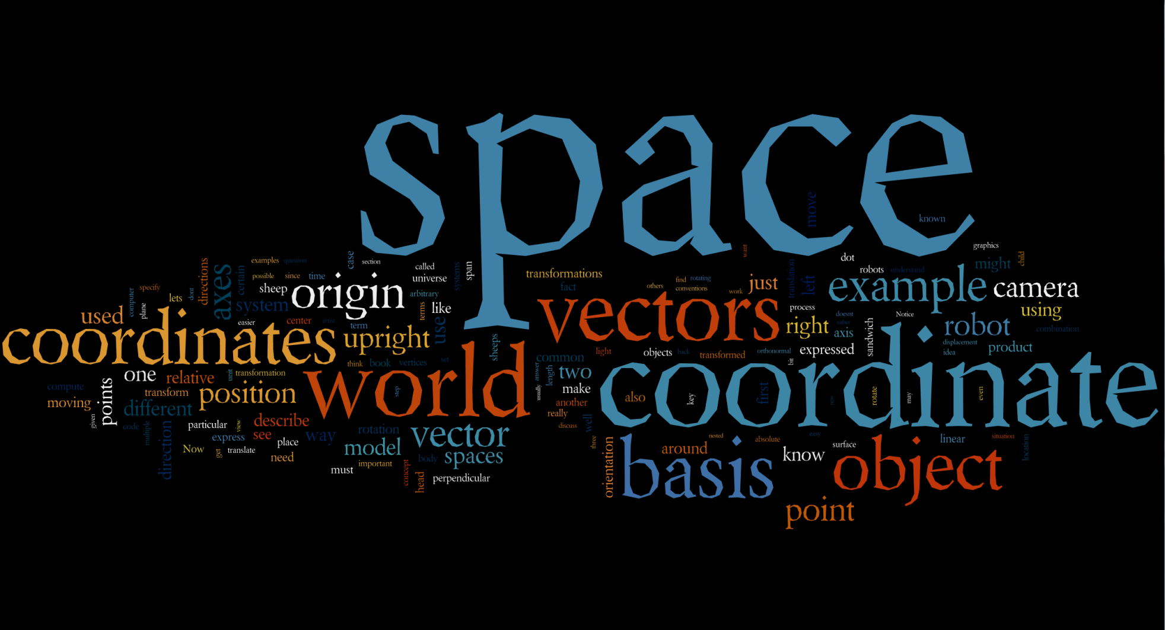
Word Cloud

Slide 4
Section 3.1: Why Multiple Coordinate Spaces?

Slide 5
Why Multiple Coordinate Spaces?
Some things become easier in the correct coordinate space.
There is some historical precedent for this observation (next slide).
We can leave the details of transforming between coordinate spaces to the graphics hardware.

Slide 6
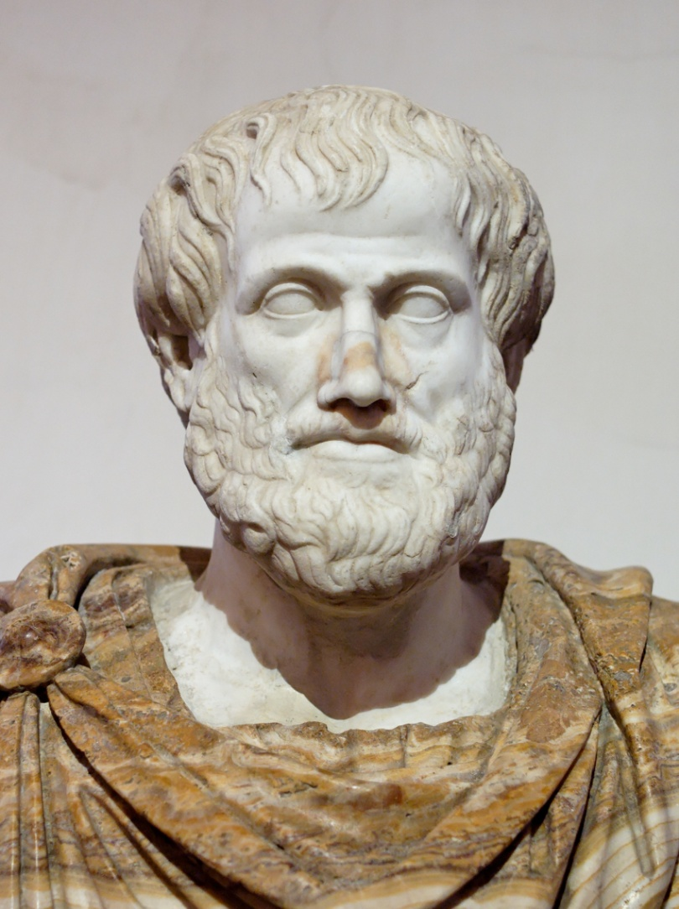
Aristotle
Aristotle (384-322 BCE) proposed a geocentric universe with the Earth at the origin.
(Image from Wikimedia Commons)

Slide 7
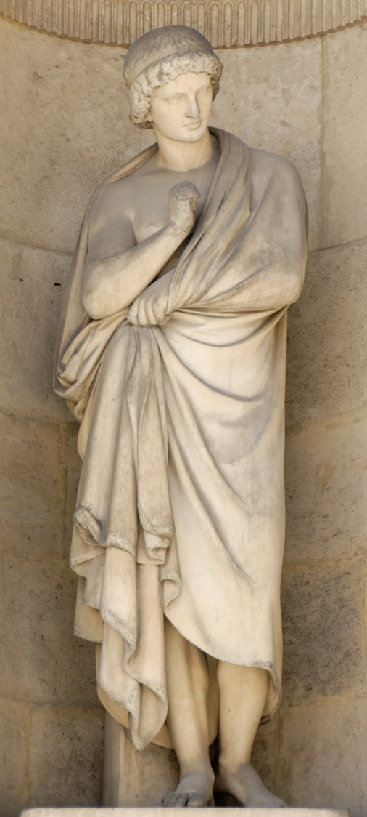
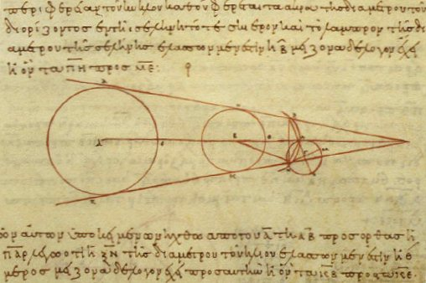
Aristarchus
Aristarchus (ca. 310-230 BCE) proposed a heliocentric universe with the Sun at the origin.
(Images from Wikimedia Commons)

Slide 8

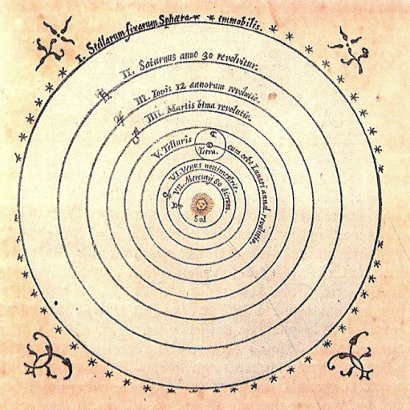
Copernicus
Nicholas Copernicus (1473-1543) observed that the orbits of the planets can be explained more simply in a heliocentric universe.
(Images from Wikimedia Commons)

Slide 9
Section 3.2: Some Useful Coordinate Spaces

Slide 10
Some Useful Coordinate Systems
World space
Object space
Camera space
Upright space

Slide 11
World Space
World space is the global coordinate system.
Use it to keep track of position and orientation of every object in the game.
Just like in the movie Highlander, there can be only one.

Slide 12
Object Space
Every object in the game has:
Its own origin (where it is),
Its own concept of “up” and “right” and “forwards”,
That is, its own coordinate space.
Use it to keep track of relative positions and orientation (eg. Collision detection, AI)

Slide 13
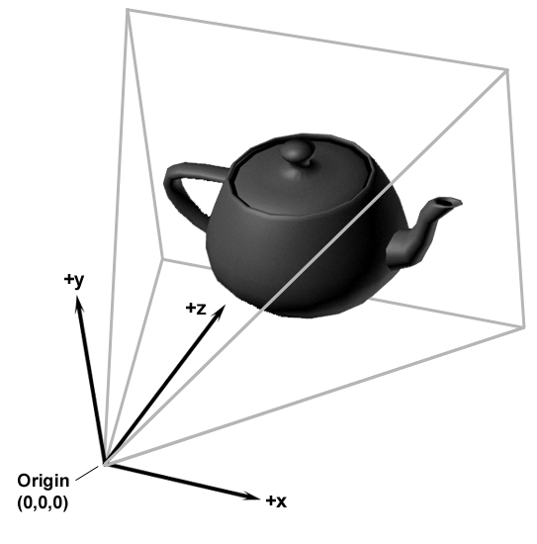
Camera Space
Object space for the viewer, represented by a camera, used to project 3D space onto screen space

Slide 14
Camera Space Terminology
Frustum: the pyramid of space seen by the camera
Clipping: objects partially on screen
Occlusion: objects hidden behind another object
Visibility: inside or outside of frustum, occluded, clipped

Slide 15
Upright Space
Upright space is in a sense “half way” between world space and object space.
Upright space has
Object space origin
World space axes
It is nonstandard, we use it in our book because we like it.

Slide 16
Object, Upright, and World Space

Slide 17
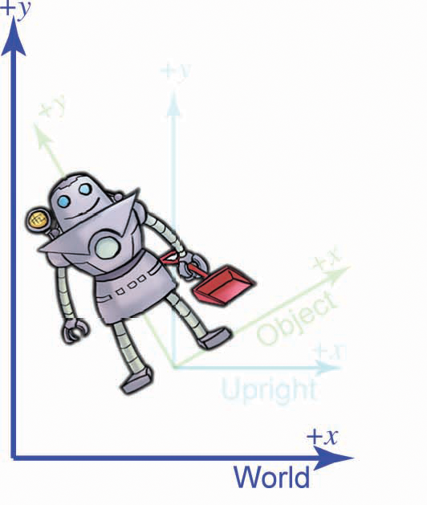
Robot in World Space

Slide 18
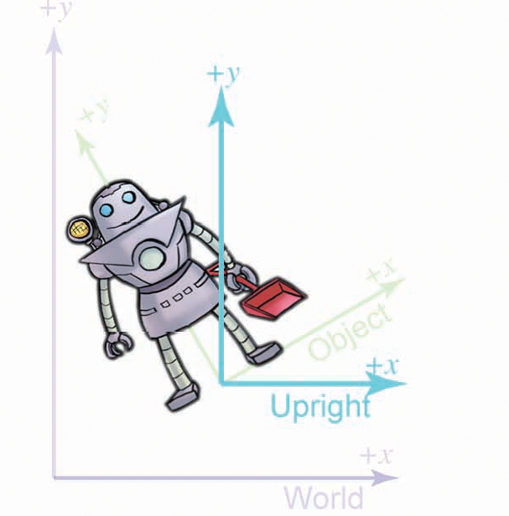
Robot’s Upright Space

Slide 19
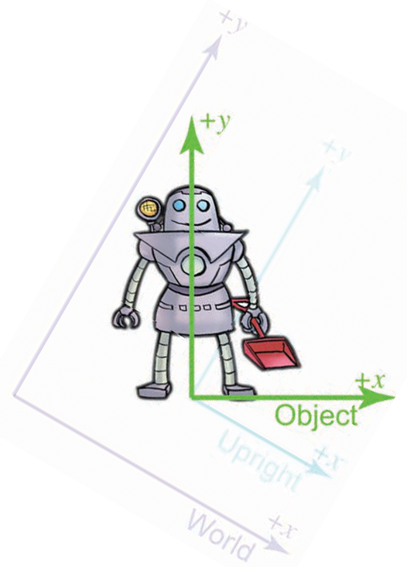
Robot’s Object Space

Slide 20
Why Upright Space?
It separates translation and rotation
It is a handy visualization tool
It is inspired by both math and hardware implementation
Translate between world and upright space.
Rotate between upright and object space.
Which brings us to coordinate space transformations…

Slide 21
Section 3.3: Coordinate Space Transformations

Slide 22
Coordinate Space Transformation
Two important types of transformation used to transform one coordinate space into another:
Translation
Changes position in space
Gives new location of origin
Rotation
Changes orientation in space
Gives new directions of axes

Slide 23
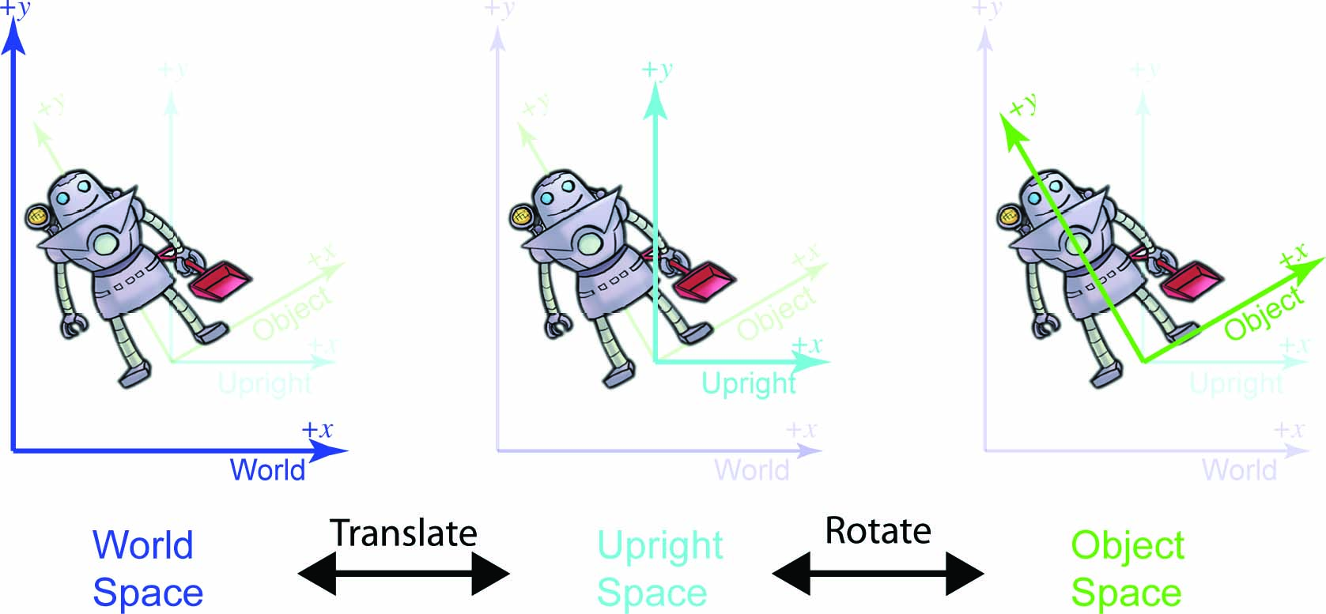

Slide 24

Example
Let's say that we are working for a advertising agency that has just landed a big account with a food manufacturer.
You are assigned to the project to make a slick computer-generated ad promoting one of their most popular items, Herring Packets, which are microwaveable herring sandwiches food products for robots.
Of course, the client has a tendency to want changes made at the last minute, so we need to be able to get a model of the product at any possible position and orientation.

Slide 25
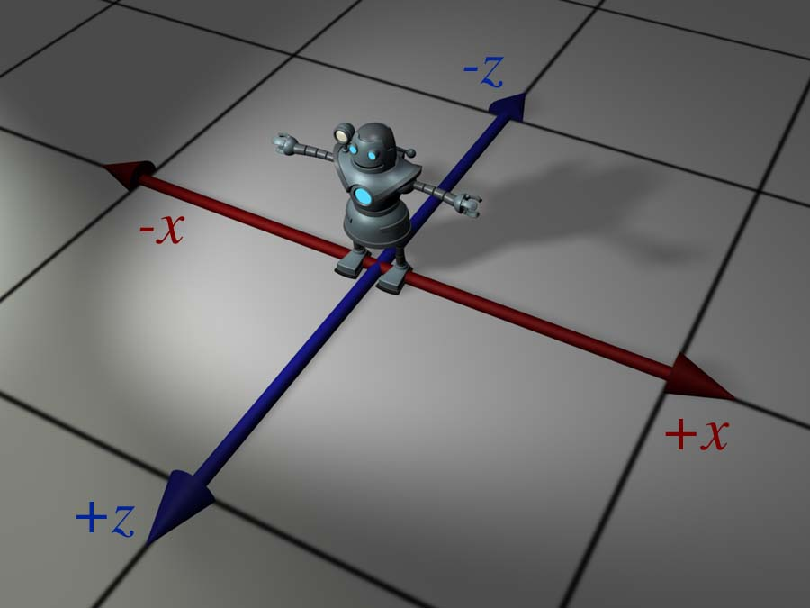
Start with the Artist’s Model
For now, because we have the model in its home position, object space and world space (and upright space) are all the same by definition.
For all practical purposes, in the scene that the artist built containing only the model of the robot, world space is object space.

Slide 26
Goal Transformation
Our goal is to transform the vertices of the model from their home location to some new location (in our case, into a make-believe kitchen), according to the desired position and orientation of the robot based on the executive’s whims at that moment.
See next slide…

Slide 28
More Details
Let's talk a bit about how to accomplish this. We won't get too far into the mathematical details - that's what the rest of this chapter is for.
Conceptually, to move the robot into position we first rotate her clockwise 120° (or, as we'll learn in Chapter 8, by “heading left 120 °”).
Then we translate 18ft east and 10ft north, which according to our conventions is a 3D displacement of [18, 0, 10].

Slide 29
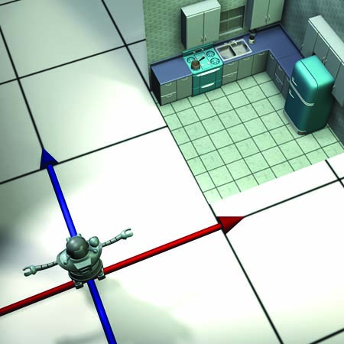
Original Position

Slide 30
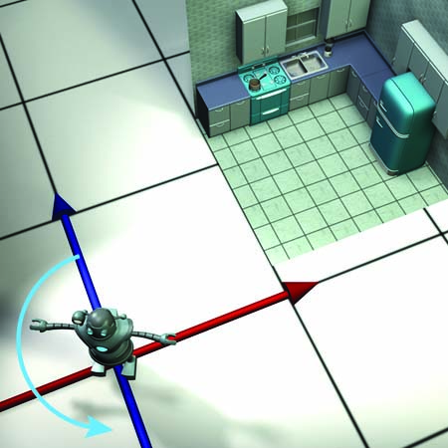
Rotate

Slide 31
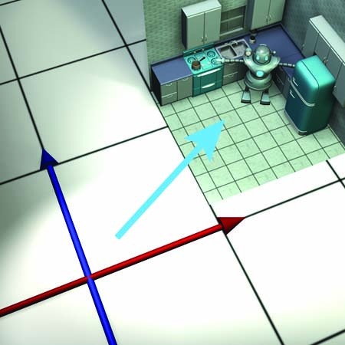
Then Translate

Slide 32
Rotate Before Translate
Why rotate before we translate?
Rotation about the origin is easier – translating first would mean that we have to rotate around an arbitrary point.
Rotation about the origin is a linear transform.
Rotation about an arbitrary point is an affine transform.
Affine transforms can be expressed as a sequence of primitive operations.

Slide 33
Camera Space
So we've managed to get the robot model into the right place in the world.
But to render it, we need to transform the vertices of the model into camera space.
In other words, we need to express the vertices' coordinates relative to the camera. For example, if a vertex is 9ft in front of the camera and 3ft to the right, then the z and x coordinates of that vertex in camera space would be 9 and 3, respectively.

Slide 34
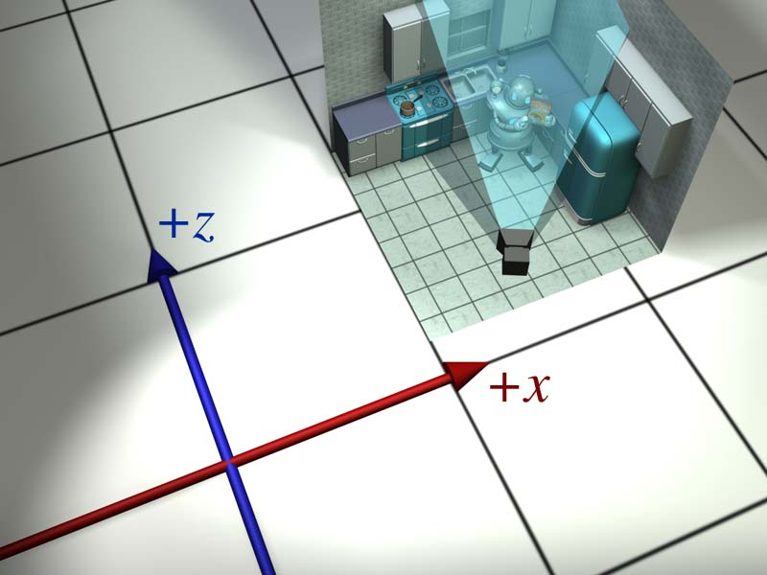

Where the camera is
What the camera sees

Slide 35
Camera Space
It’s easier to reason about a camera at the origin, looking along a primary axis.
So we move the whole world so that the camera is at the origin.
First we translate, then we rotate (for the same reason as before, because rotation about the origin is easier than rotation about an arbitrary point).

Slide 36
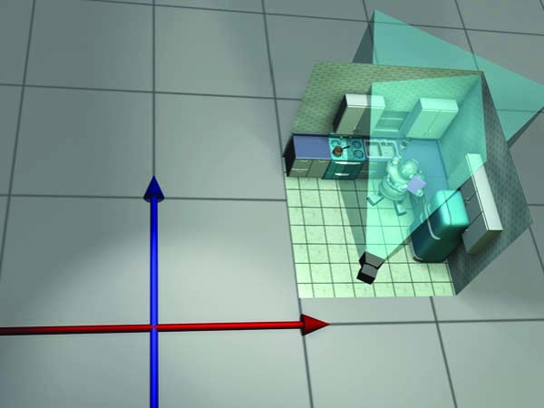
Original Position

Slide 37
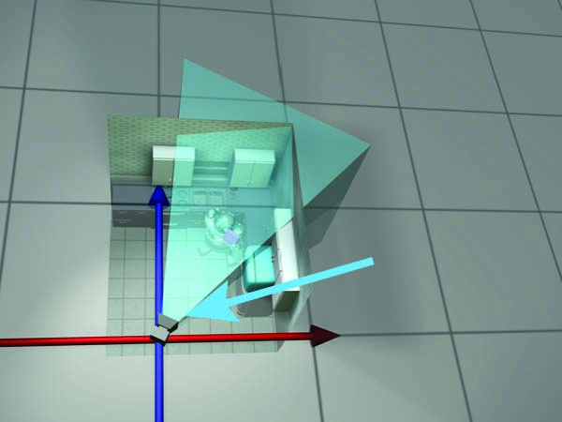
Translate the World

Slide 38
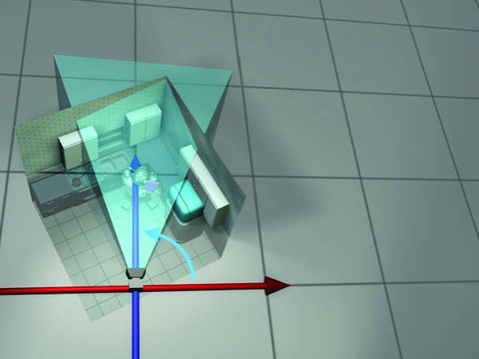
Rotate the World

Slide 39
Transform to Camera Space
We use the opposite translation and rotation amounts, compared to the camera's position and orientation.
For example, in Figure 3.9 the camera is at
(13.5, 4, 2).
So to move the camera to the origin, we will translate by [-13.5, -4, -2].
The camera is facing roughly northeast and thus has a clockwise heading compared to north; a counter-clockwise rotation is required to align camera space axes with the world space axes.

Slide 40
Notes
The world space → camera space transform is usually done inside the rendering system, often on a dedicated graphics processor.
Camera space isn't the finish line" as far as the graphics pipeline is concerned. From camera space, vertices are transformed into clip space and finally projected to screen space.

Slide 41
Basis Vectors: Example
Suppose we need the world space coordinates of the light on the robot's right shoulder.
Start with its object-space coordinates, (-1, 5).
How do we get the world-space coordinates?
Start at her origin.
Move to the right 1 foot.
Move up 5 feet.
The terms “to the right” and “up” are in object space. We know that the robot's “to the left” vector is [0.87, 0.5], and the robot's “up” vector is [-0.5, 0.87]

Slide 42
Doing the Arithmetic
Start at the origin. No problem, we know her origin is (4.5, 1.5).
Move to the right 1 foot. We know that the vector “the robot's left” is [0.87, 0.50], and so we scale this direction by the distance of -1 unit, and add on the displacement to our position, to get
(4.5, 1.5) + (-1) [0.87, 0.5] = (3.63, 1).
Move up 5 feet. Once again, we know that “the robot's up” direction is [-0.50, 0.87], so we just scale this by 5 units and add it to the result, yielding
(4.5, 1.5) - [0.87, 0:5] + 5 [-0.5, 0.87] = (1.13, 5.35)

Slide 43
Check the Result
If you look again at the Figure, you'll see that the world-space coordinates of the light are, indeed (1.13, 5.35).

Slide 44
Abstract the Process
Let b be a point with object-space coordinates b = (b_{x}, b_{y}).
Let w = (w_{x}, w_{y}) be the world-space coordinates of b.
We know the world space coordinates for the origin o and the right and up directions, which we will denote as p and q, respectively.
Now w can be computed by
w = o + b_{x}p + b_{y}q

Slide 45
Basis Vectors
Now let's be even more general. It will help greatly to remove translation from consideration.
Geometrically, any vector may be decomposed into a sequence of axially-aligned displacements.
Thus an arbitrary vector v can be written as
v = xp + yq + zr
Here, p, q and r are basis vectors for 3D space.
v is a linear combination of the basis vectors.

Slide 46
Notes
Mostly, p = [1, 0, 0], q = [0, 1, 0], and r = [0, 0, 1].
This is always true when expressed in the coordinate space for which they are the basis, but relative to some other basis they can have arbitrary coordinates.
Basis vectors are usually mutually perpendicular, for example, p x q = r, but they don’t have to be.
Basis vectors are usually unit length, but they don’t have to be. They may not even have the same length.

Slide 47
They Don’t Have to be Parallel

Slide 48
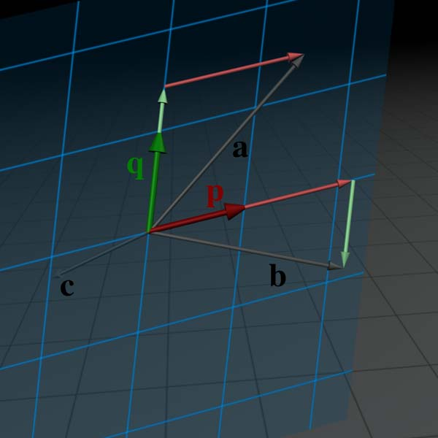
The Span
The set of vectors that can be expressed as a linear combination of the basis vectors is called the span of the basis.
The span of a pair of vectors in a 3D space is usually a plane.
Consider the vector c, which lies behind the plane in this figure.

Slide 49
Rank
The vector c is not in the span of p and q, which means we cannot express it as a linear combination of the basis vectors.
In other words, there are no such coordinates [c_{x}, c_{y}] such that c = c_{x} p + c_{y} q.
The term used to describe the number of dimensions in the space spanned by the basis is the rank of the basis.
In the examples so far, we have two basis vectors that span a two dimensional space.
Clearly, if we have n basis vectors, the best we can hope for is full rank, meaning the span is an n-dimensional space.
But it can be less. For example, if the basis vectors are linearly dependent.

Slide 50
Poor Bases
So a set of linearly dependent vectors is certainly a poor choice of basis. But there are other more stringent properties we might desire of a basis.
Suppose that we have an object body whose basis vectors are p, q, r, and we know the coordinates of these vectors in world space.
Let b = [b_{x}, b_{y}, b_{z}] be the coordinates of some arbitrary vector in body space.
Let u = [u_{x}, u_{y}, u_{z}] be the coordinates of that same vector in upright space.

Slide 51
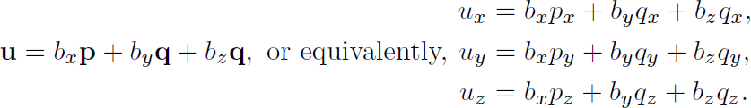
From the Robot Example
From our robot example, we already know the relationship between u and b.
What if u is known and b is the vector we’re trying to determine?

Slide 52
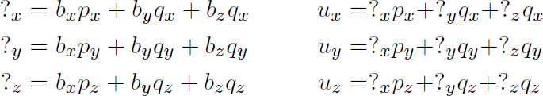
Systems of Equations
Let's write the two systems side-by-side, only we'll replace the unknown vector with '?'.

Slide 53
Solving Systems of Equations
The system of equations on the left is not really much of a “system” at all, it's just a list: each equation is independent, and each unknown quantity can be immediately computed from a single equation.
On the right, however, we have three interrelated equations, and none of the unknown quantities can be determined without all three equations.
In fact, if the basis vectors are linearly dependent, then the system on the right may have zero solutions (if u is not in the span), or it might have an infinite number of solutions (if u is in the span but the coordinates are not uniquely determined).

Slide 54
Linear Algebra to the Rescue?
Linear algebra provides a number of general-purpose tools for solving systems of linear equations like this, but we don't need to delve into these topics, as the solution to this system is not our primary aim.
For now, we're interested in understanding a special situation where the solution is easy.
In Chapter 6 we'll learn how to use the matrix inverse to solve the general case.

Slide 55
Dot Product to the Rescue
The dot product is the key. Remember from Chapter 2 that the dot product can be used to measure distance in a particular direction.
When using the standard basis p = [1, 0, 0], q = [0, 1, 0], and r = [0, 0, 1] (corresponding to the object axes being parallel with the world axes in our robot example), we can dot the vector with a basis vector to “sift out” the corresponding coordinate…

Slide 56
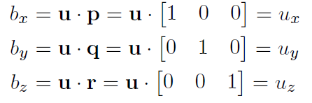
Simple Sifting
But does this “sifting” action work for any arbitrary basis?
No. In fact we can see that it doesn't work for the example we have been using.
The figure on the next slide compares the correct coordinates a_{x}, a_{y} with the dot products a∙p and a∙q.

Slide 57
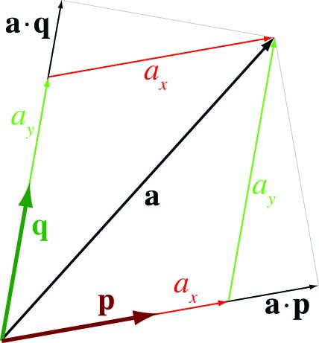
Failure to Sift
The illustration is only completely correct if p and q are unit vectors.
The dot product doesn't “sift out" the coordinate in this case.
Notice that in each case, the result produced by the dot product is larger than the correct coordinate value.
Why is this?

Slide 58
Here’s Why it Fails
Dot product measures displacement in a given direction.
But a coordinate value does not simply measure the amount of displacement from the origin along a given direction!
A coordinate is a coefficient in the expansion a = xp + yq.
The reason the dot product doesn't work in this case is because we are ignoring the fact that yq will cause some
displacement parallel to p.
To visualize this, imagine in the preceding figure that we increased a_{x} while holding a_{y} constant.
As a moves to the right and slightly upwards, its projection onto q, which is measured by the dot product, increases.

Slide 59
Synopsis
The problem is that the basis vectors are not perpendicular.
A set of basis vectors that are mutually perpendicular is called an orthogonal basis.
When the basis are orthogonal, the coordinates are uncoupled. Any given coordinate of a vector v can be determined solely from v and the corresponding basis vector.
For example, we can compute the v_{x} coordinate knowing only p, provided q and r are perpendicular to p.

Slide 60
Orthonormal Bases
It's the best when the basis vectors all have unit length too.
Such a set of vectors are known as an orthonormal basis.
Why is the unit length helpful? Remember the geometric definition of the dot product: a∙p is equal to the signed length of a projected onto p, times the length of p.
If the basis vector doesn't have unit length, but it is perpendicular to all the others, we can still determine the corresponding coordinate using the dot product, we just need to divide by the square of the length of the basis vector.

Slide 61
Wrapping it Up
Thus, in the special circumstance of an orthonormal basis, we have a simple way to determine the object-space coordinates, knowing only the world-coordinates of the body axes.
b_{x} = u ∙ p
b_{y} = u ∙ q
b_{z} = u ∙ r

Slide 62
Section 3.4: Nested Coordinate Spaces

Slide 63
Nested Coordinate Spaces
An object may have multiple coordinate spaces representing parts of the object (eg. Upper arm, forearm, hand).
Transform from parent to child:
Upper arm, forearm, hand (origin at shoulder)
Forearm, hand (origin at elbow)
Hand (origin at wrist)
Allows expression of complicated motion as a combination of simple relative motions.

Slide 64
That concludes Chapter 3. Next, Chapter 4: Introduction to Matrices

